Slide 1

Deep Learning- Computer Vision

Slide 2
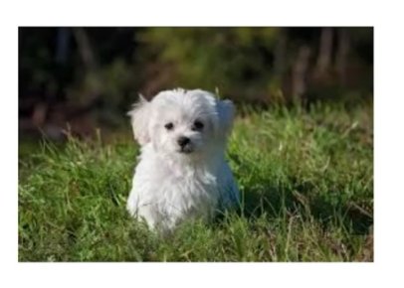
Image classification: What object is present in the image

Slide 3
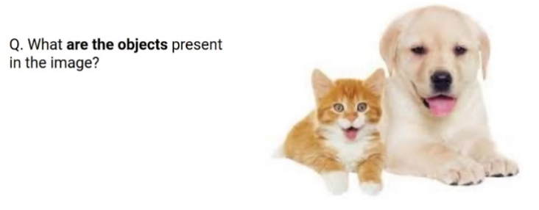
Multi-class image classification

Slide 4
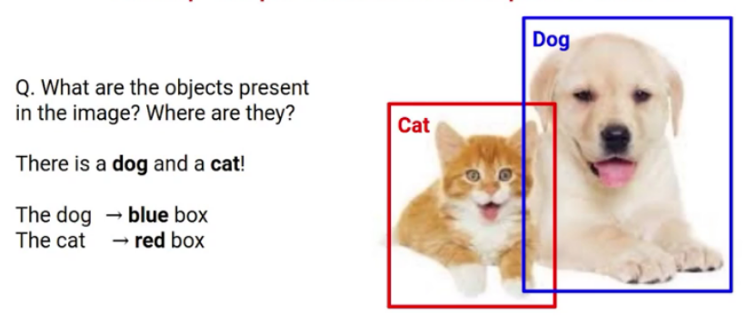
Object Detection

Slide 5
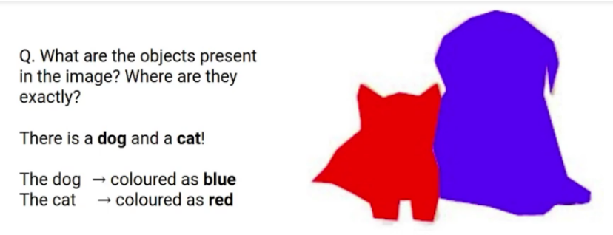
Image segmentation

Slide 6
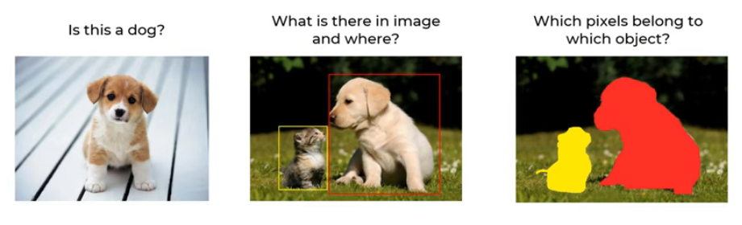
Image classification Vs. Object Detection Vs. Image segmentation

Slide 7
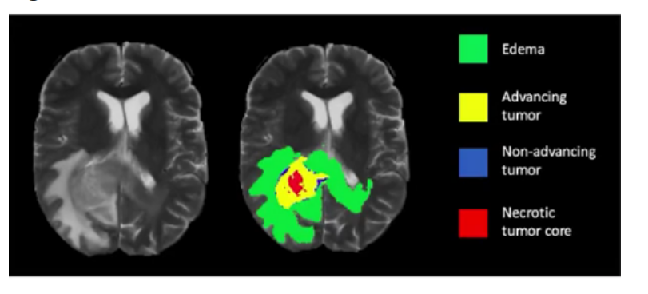
Medical Image

